Slide 1
SONGs Information Session Committee Presents:
Masters Tri-Council Scholarship
Information Session
Presented by: Kate Onuska
Chair of the Information Session Committee
https://songsuwo.ca/information-sessions

Slide 2
Overview
1. What is the Tri-Council CGS M Program?
2. Who is eligible?
3. Which agency should you apply to?
4. Timeline and overview of the components of the application.

Slide 3
The Canada Graduate Scholarships – Masters Program
The Canada Graduate Scholarships – Masters (CGS M) program is a federal program of scholarships awarded through national competitions by the granting agencies:
1. The Canadian Institutes of Health Research (CIHR)
2. The Natural Sciences and Engineering Research Council of Canada
(NSERC)
3. The Social Science and Humanities Research Council (SSHRC).
Canada’s three federal granting agencies have created the Masters (CGS-M) Program which involves a new common CGS-M webpage, a harmonized timeline, and evaluation criteria. ​

Slide 4
NSERC
CGS M Scholarship
$17 500 for 12 months, non-renewable
Western CGS M Funding Quotas 2021:
SSHRC
CIHR
For social science research
For natural science research
For clinical research
41
29
28
CGS M Allocations
Notes:
* Include later slide on feedback differences between CIHR and NSERC

Slide 5
Applicant Eligibility
To be eligible to apply for a CGS M award, an applicant must:
1) Be a Canadian citizen or a permanent resident of Canada, as of the application deadline date
2) Be enrolled in, have applied for or will apply for full-time admission to an eligible Masters program at a Canadian institution with a CGS M allocation
3) Respect the internal deadline to apply for admission for your intended program of study (Western’s is December 1st !)
4) Have completed, as of December 31 of the year of application either between 0 and 12 months of full-time studies (or full-time equivalent) in a Masters program
5) Have not held or currently hold a CGS M scholarship from CIHR, NSERC or SSHRC
6) Have achieved a first-class average, as determined by the host institution, in each of the last two completed years of study (full-time equivalent)
Note: Institutions may, at their discretion, accept CGS M applications from individuals who have not obtained a first-class average; contact your proposed host institutions to determine their use of this eligibility criterion
7) Submit a maximum of one scholarship application per academic year to either CIHR, NSERC or SSHRC

Slide 6
Determining Which Funding Agency is Right for You
1. Talk to your supervisor about which agency your research project/ proposal would be the
best fit for (especially if your research includes both clinical and non-clinical work!)
2. Check to see which funding agency your supervisor is typically funded under.
Check out the eligibility guidelines in more detail at: http://science.gc.ca/eic/site/063.nsf/eng/h_FEE7261A.html?OpenDocument

Slide 7
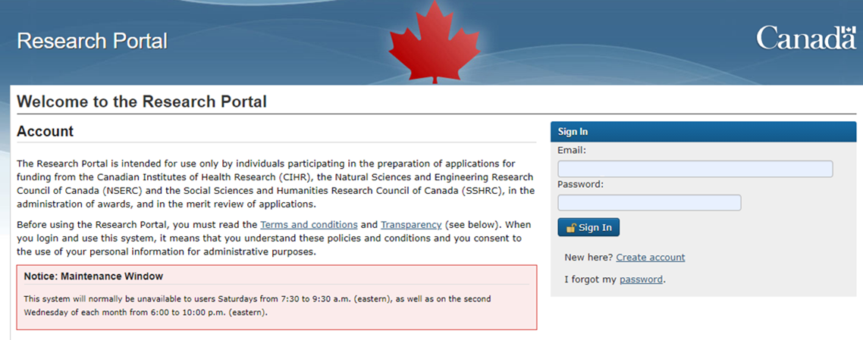
The Application: In the Portal
Instructions on How to Complete the CGS M Application

Slide 8
Application Requirements: Identity and Activity Information
Identification
1. Applicant
2. Application Title
3. Field of Research*
4. Proposed start date
5. Number of months of graduate studies completed as of Dec 31st
6. Proposed Host Institution (for all current Neurograds, this is Western University ☺ )
Activity details
1. Certification requirements (ie. Animal Use, Biohazard etc.)
2. Statistical questions (ie. Gender and Sex)
3. Key words
4. Field of study
Notes:
Identification as in your name.
Michael smo
Can do up to 3 host institutions

Slide 9
Application Requirements: The Summary
Summary of the Proposal: A brief summary (maximum of 1,800 characters including spaces) of your outline of proposed research in language that the public can understand.
This plain-language summary may be made available to the public if your application is successful.

Slide 10
CGS M Application Centralized Criteria
The centralized criteria provides a weighted basis for how you should:
1) Shape the components of your written application, including your:
a. Research Proposal (1 page).
2) Inform what should be included in your CCV.
3) The information that should be highlighted and discussed by your references (x2).

Slide 11
Coordinate Efforts
There is a limited amount of information you can include, and some things require some depth. If you can spread out the in-depth parts, it can give a fuller picture of you as a researcher!
Outline of proposed research
Theses completed or in progress
Most significant contributions to research and development
Applicant’s autobiographical statement
Reports on the applicant
Notes:
You can make references to your research/goals/ achievements in different areas, but don’t repeat yourself. If your completed thesis is your most significant contribution, you can break it up into – the specific scientific results and place in research, why it was really important, and then what you learned, any mentoring/ acheivements
Theses completed etc gets the results and a bit of relevance, most sig cont…. Gets why it is really important, and you can remind your referees about any mentoring, learning or development that occurred as a result that they can point to. If it is related to your proposal, great, but don’t repeat yourself, saying you have experience in the methods/field from my thesis is probably plenty

Slide 12
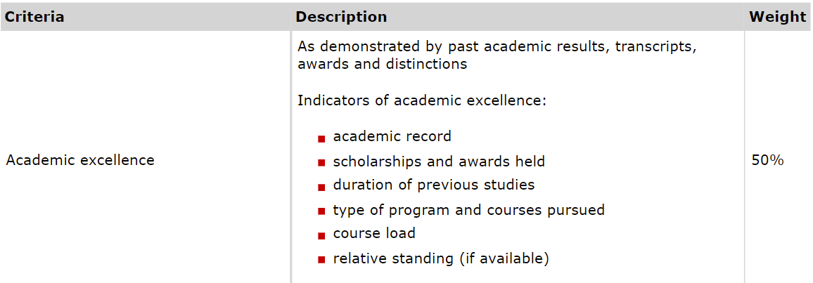
Part I: Centralized Criteria – Academic Excellence

Slide 13
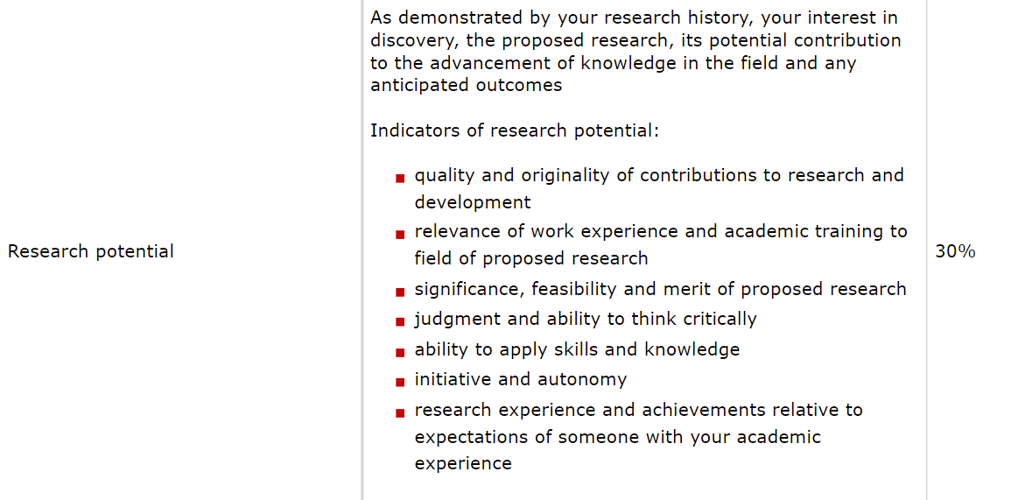
Part II: Centralized Criteria – Research Potential

Slide 14
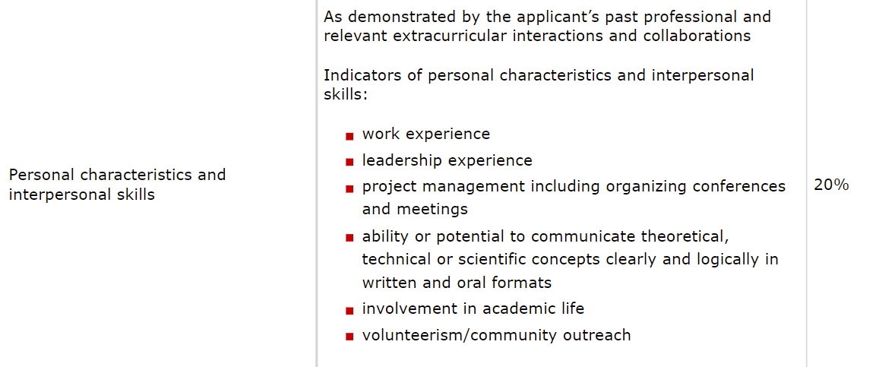
Part III: Centralized Criteria – Personal/Interpersonal Skills

Slide 15
Application Requirements: PINs
For both CIHR and NSERC, applicants must get a PIN. This will be unique to your application and will be needed for completing your application in either portal.
How to get a CIHR PIN: https://cihr-irsc.gc.ca/e/38201.html
How to get an NSERC PIN: https://www.nserc-crsng.gc.ca/OnlineServices-ServicesEnLigne/FAQ-FAQ_eng.asp#a4

Slide 16
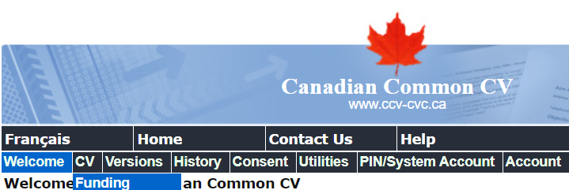
Application Requirements: The Canadian Common CV
A web-based application that provides a single, common approach to gathering CV information required for funding agencies.
Steps:
1. If you do not have one, create a CCV account: Welcome to the Canadian Common CV (ccv-cvc.ca)
2. Login, and navigate to the “Funding” subheading under CV:
How to Complete the CGS M CCV

Slide 17
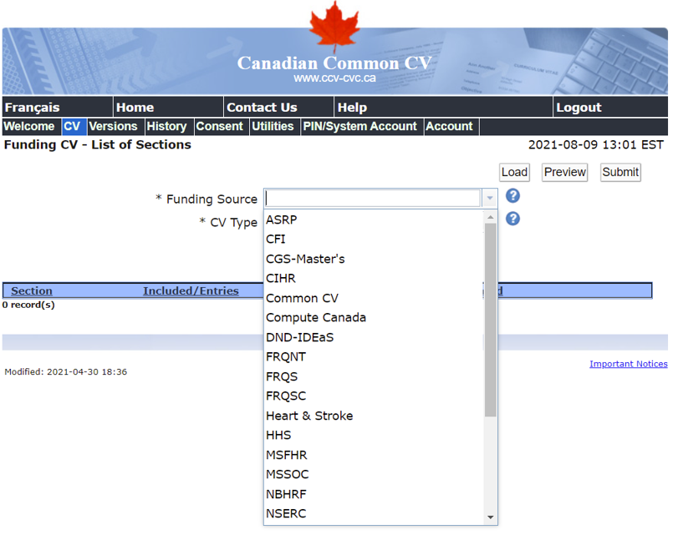
Application Requirements: The Canadian Common CV
A web-based application that provides a single, common approach to gathering CV information required for funding agencies.
Steps:
3. Under “Funding Source”, choose CGS-Master’s
4. Fill out required fields!
How to Complete the CGS M CCV

Slide 18
Application Requirements: The Scientific Research Proposal
Outline of Proposed Research (maximum one page): A detailed description of your proposed research project for the period during which you will hold the award.
The scientific research proposal should include:
Background
Objectives
Hypothesis
Outline of experimental or theoretical approach (citing pertinent literature)
Methods
Significance of the proposed research to your field.
Bibliography (maximum one page): Provide a bibliography that includes citations for all works referenced in the proposal. Should be in a format used by the primary discipline of the research

Slide 19
Application Requirements: Up-to-Date Official Transcripts
Up-to-date official transcripts are a mandatory requirement of all Tri-Agency scholarship competitions.
Transcripts must be scanned (black and white recommended) and saved as a single PDF file.
Transcript text orientation should be upright (if possible) and must be readable on a computer monitor without any adjustment by the viewer.
Opening the transcript envelope and scanning the transcript will not render the transcript unofficial.
One copy of an institution’s legend must be included as the last page of that institution’s transcript.
Applications that do not have adequate documentation to prove applicant eligibility will be irreversibly rejected.
1) Up-to-date transcripts: defined as official transcripts dated or issued in the Fall 2021 term (if currently registered) OR after the last term completed (if not currently registered).
2) Official transcripts: defined as transcripts issued by the institution’s registrar’s office. Transcripts from other sources, such as those printed from the student’s account on the institution’s website, are not official.
Ordering Western official transcripts must now be done online for either pick-up or mail delivery. https://www.registrar.uwo.ca/services/transcripts.html

Slide 20
Application Requirements: References
Tips for Selecting Your Referees
Select referees who know you well and can make an informed assessment based on the weighted criteria provided by the Tri-Funding Agencies .
Consider past and/or current supervisors!
2. Be up front and ask your potential referees if they have the time and can provide a supporting
assessment that will speak to all aspects of the strengths of the application.
Provide your potential referees with a package of information that will assist them with writing
the appraisal. This package could contain:
A) Current curriculum vitae
B) Transcripts
C) List of research contributions; ask your referees to address the importance of your
publications/contributions in their assessment.
D) A representative copy of the research proposal
If you haven’t already, contact your references!

Slide 21
Timeline: Submitting the Application
Day Before Deadline: a) Compile all final documents b) Fill out checklist
2 Months Before Deadline: a) Decide which funding agency to submit to.
2 Weeks Before Deadline: a) Peer review of proposal (family/friends/Neuro grads) b) Supervisor/Lab Members review
1.5 – 1 Month Before Deadline: a) Order Transcripts. b) Contact Referees (x2). c) Start planning your research proposal.
d) Conduct literature review.
Day Before Deadline: a) Compile all final documents b) Fill out checklist

Slide 22
Timeline: After the Application
Offers are available in the research portal as of April 1st , 2022.
Offers to alternate applicant may be made up until January 31st , 2023 (the next calendar year!) It is the responsibility of the applicant to regularly check the research portal between April 1 and January 31 for results of the competition.
Conditions
a) Location: must be at the institution where the offer of award originates.
b) Policies and Guidelines: Applicants and award holders must comply with
the policies and guidelines set out in the Tri-agency research training
award holder’s guide and in any other documents related to scholarship
applications and awards.

Slide 23
Contact Information
Neuroscience Administration
susan.simpson@schulich.uwo.ca
Neuroscience Faculty
bbutler9@uwo.ca
Neuroscience Graduate Students Me: konuska@uwo.ca Hayley: hshanks@uwo.ca
CIHR support-soutien@cihr-irsc.gc.ca
NSERC schol@nserc-crsng.gc.ca
SSHRC fellowships@sshrc-crsh.gc.ca

