Slide 1
SONGs Information Session Committee Presents:
Doctoral Tri-Council Scholarship
Information Session
Presented by: Kate Onuska
Chair of the Information Session Committee
https://songsuwo.ca/information-sessions

Slide 2
Overview
1. What is the Tri-Council CGS D Program?
2. Who is eligible?
3. Which agency should you apply to?
4. Timeline and overview of the components of the application.

Slide 3
The Canada Graduate Scholarships – Doctoral Program
The Canada Graduate Scholarships – Doctoral (CGS D) program is a federal program of scholarships awarded through national competitions by the granting agencies:
1. The Canadian Institutes of Health Research (CIHR)
2. The Natural Sciences and Engineering Research Council of Canada
(NSERC)
3. The Social Science and Humanities Research Council (SSHRC).
Canada’s three federal granting agencies have harmonized the Doctoral (CGS-D) Program which involves a new common CGS-D webpage, a harmonized timeline, and evaluation criteria. ​

Slide 4
NSERC
For non-clinical research
1) Alexander Graham Bell Canada Graduate Scholarships-Doctoral (CGS-D) Program
2) NSERC Postgraduate Scholarships-Doctoral (PGS-D) Program
*These fall under the same scholarship process
CGS-D: $35,000 per year for 2 or 3 years
PGS-D: $21,000 per year for 2 or 3 years
Western NSERC Funding Quota:
2019 2018 17 PGS-D 19 PGS-D 12 CGS-D 18 CGS-D
Notes:
* Include later slide on feedback differences between CIHR and NSERC

Slide 5
CIHR
For clinical research
Frederick Banting & Charles Best Canada Graduate Scholarships-Doctoral Awards (CGS-D) Program
$5000 “Academic” Fund
CGSD: $35,000 per year for 36 months
Western CIHR Funding Quota:
2020
13 CGS-D
$30 000 Scholarship

Slide 6
Applicant Eligibility
An applicant must:
1) Be a Canadian citizen or a permanent resident of Canada, as of the application deadline date
2) Have completed no more than 24 months of full-time study in their doctoral program by December 31 of the calendar year of application if previously enrolled in a master’s program.
3) Have completed no more than 36 months of full-time study in their doctoral program by December 31 of the calendar year of application if enrolled in a joint program; for example, MD/PhD, MA/PhD applicants who fall into this category have access to the 36-month window whether or not they were previously enrolled in a master’s program.
4) Have completed no more than 36 months of full-time study in their doctoral program by December 31 of the calendar year of application if enrolled directly from a bachelor’s to a PhD program (with no time spent in a master’s program) Note: direct-entry applicants must be enrolled in their doctoral program at the time of application
5) If you were registered in a master’s program and subsequently transferred to a doctoral program (fast-track/roll-over), the months of study completed are calculated starting from the date on which you transferred into the doctoral program.

Slide 7
Determining Which Funding Agency is Right for You
1. Talk to your supervisor about which agency your research project/ proposal would be the
best fit for (especially if your research includes both clinical and non-clinical work!)
2. Check to see which funding agency your supervisor is typically funded under.
Check out the eligibility guidelines in more detail at: http://science.gc.ca/eic/site/063.nsf/eng/h_FEE7261A.html?OpenDocument

Slide 8
Application Process
Online application submitted through Western University
Deadline: Friday September 24, 2021 (8:00 p.m. EDT)
Application Forms:
CIHR: ResearchNET (learn more at https://grad.uwo.ca/finances/external_funding/cihr.html)
NSERC: NSERC Online System (learn more at https://grad.uwo.ca/finances/external_funding/nserc.html)
SSHRC: SSHRC Online System
1) Western will review all applications received, rank them and submit the recommended applications to the agencies by November 21st
2) Online direct application to Council Agency: October 17th
Notes:
MAKE A PIN

Slide 9
Up-to-Date Official Transcripts
Up-to-date official transcripts are a mandatory requirement of all Tri-Agency scholarship competitions.
Transcripts must be scanned (black and white recommended) and saved as a single PDF file.
Transcript text orientation should be upright (if possible) and must be readable on a computer monitor without any adjustment by the viewer.
Opening the transcript envelope and scanning the transcript will not render the transcript unofficial.
One copy of an institution’s legend must be included as the last page of that institution’s transcript.
Applications that do not have adequate documentation to prove applicant eligibility will be irreversibly rejected.
1) Up-to-date transcripts: defined as official transcripts dated or issued in the Fall 2021 term (if currently registered) OR after the last term completed (if not currently registered).
2) Official transcripts: defined as transcripts issued by the institution’s registrar’s office. Transcripts from other sources, such as those printed from the student’s account on the institution’s website, are not official.
Ordering Western official transcripts must now be done online for either pick-up or mail delivery. https://www.registrar.uwo.ca/services/transcripts.html

Slide 10
Up-to-Date Official Transcripts
NSERC Applicants: must send your scanned transcripts to Susan Simpson NO LATER THAN Monday, September 20th, 2021.
Note: Please also indicate Susan as your University Designate (susan.simpson@schulich.uwo.ca).
CIHR Applicants: you will upload a copy of your up-to-date official transcript to ResearchNET yourself.
Get your transcripts as soon as possible!
Ordering Western official transcripts must now be done online for either pick-up or mail delivery. https://www.registrar.uwo.ca/services/transcripts.html

Slide 11
References
If you haven’t already, contact your references!
Tips for Selecting Your Referees
Select referees who know you well and are capable of making an informed assessment based on the weighted criteria provided by the Tri-Funding Agencies .
Consider past and/or current supervisors!
2. Be up front and ask your potential referees if they have the time and can provide a supporting
assessment that will speak to all aspects of the strengths of the application.
Provide your potential referees with a package of information that will assist them with writing
the appraisal. This package could contain:
A) Current curriculum vitae
B) Transcripts
C) List of research contributions; ask your referees to address the importance of your
publications/contributions in their assessment.
D) A representative copy of the research proposal

Slide 12
PINs
For both CIHR and NSERC, applicants must get a PIN. This will be unique to your application and will be needed for completing your application in either portal.
How to get a CIHR PIN: https://cihr-irsc.gc.ca/e/38201.html
How to get an NSERC PIN: https://www.nserc-crsng.gc.ca/OnlineServices-ServicesEnLigne/FAQ-FAQ_eng.asp#a4

Slide 13
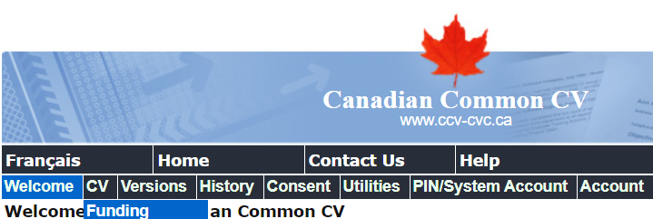
Part I: The Canadian Common CV
This applies to CIHR only!
A web-based application that provides a single, common approach to gathering CV information required for funding agencies.
Steps:
1. If you do not have one, create a CCV account: Welcome to the Canadian Common CV (ccv-cvc.ca)
Recall: if you are applying for a CIHR CGSD, you will need your CIHR pin to do this (Register with CIHR - CIHR (cihr-irsc.gc.ca)
2. Login, and navigate to the “Funding” subheading under CV:

Slide 14
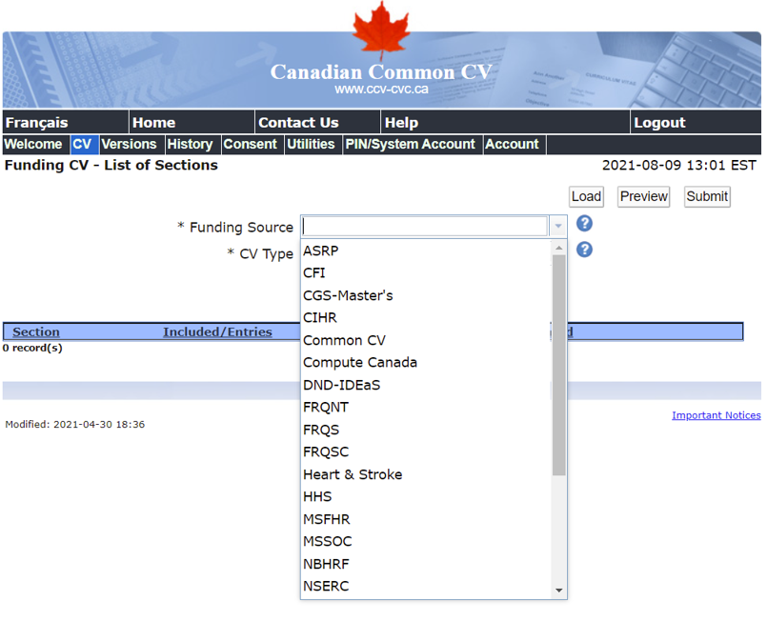
Part I: The Canadian Common CV
This applies to CIHR only!
A web-based application that provides a single, common approach to gathering CV information required for funding agencies.
Steps:
3. Under “Funding Source”, choose CIHR

Slide 15
Part I: The Canadian Common CV
This applies to CIHR only!
A web-based application that provides a single, common approach to gathering CV information required for funding agencies.
Steps:
4. Under “CV Type”, choose:
1) CIHR Academic for CIHR Funding source
5. Fill out required fields!
START EARLY
Filling out the Canadian CCV is time consuming.

Slide 16
Part II: Centralized Criteria
The centralized criteria provides a weighted basis for how you should:
1) Shape the components of your written application, including your:
a. Research Proposal (2 pages for NSERC, 1 page for CIHR).
b. Autobiographical/Contributions Statement ( 2 pages for NSERC & CIHR).
Optional for NSERC: Justification for Eligibility of Proposed Research
2) The information that should be highlighted and discussed by your references (x2).

Slide 17
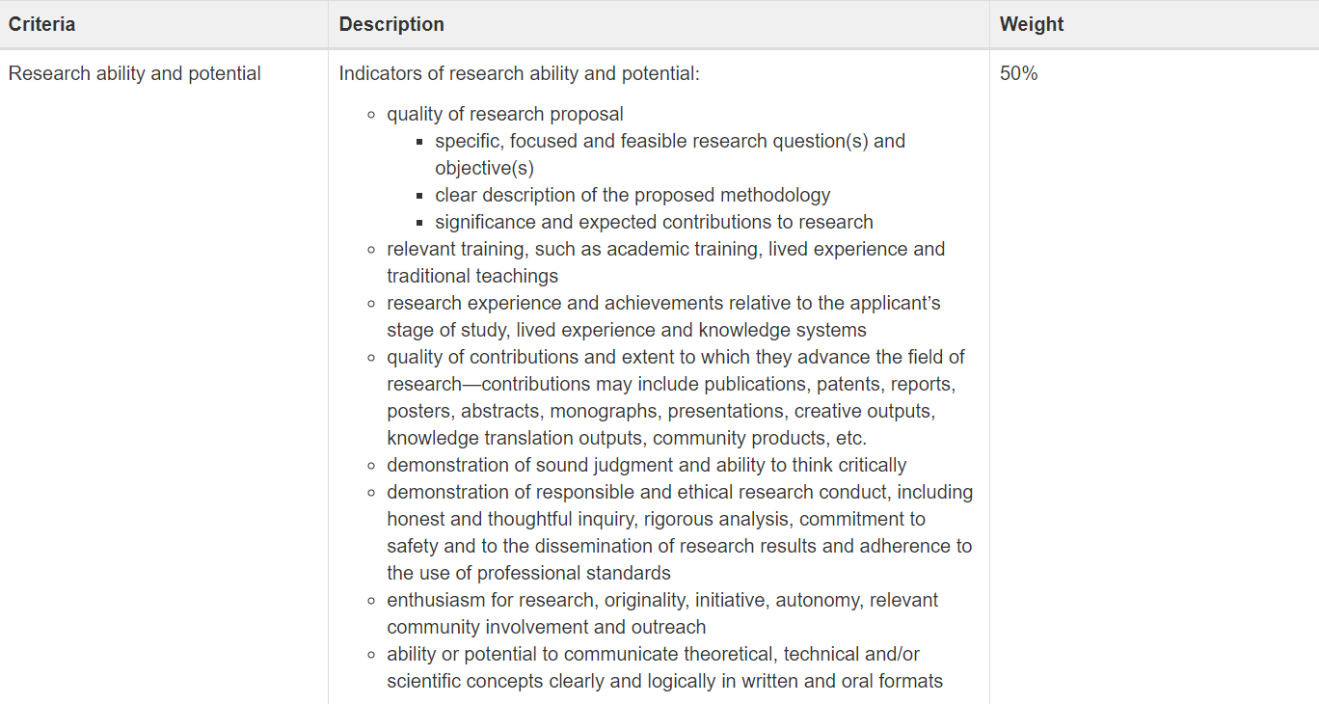
Part II: Centralized Criteria - Research

Slide 18
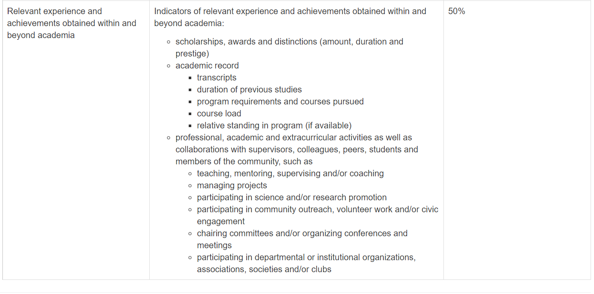
Part II: Centralized Criteria - Other Experience

Slide 19
Coordinate Efforts
There is a limited amount of information you can include, and some things require some depth. If you can spread out the in-depth parts, it can give a fuller picture of you as a researcher!
Outline of proposed research
Theses completed or in progress
Most significant contributions to research and development
Applicant’s autobiographical statement
Reports on the applicant
Notes:
You can make references to your research/goals/ achievements in different areas, but don’t repeat yourself. If your completed thesis is your most significant contribution, you can break it up into – the specific scientific results and place in research, why it was really important, and then what you learned, any mentoring/ acheivements
Theses completed etc gets the results and a bit of relevance, most sig cont…. Gets why it is really important, and you can remind your referees about any mentoring, learning or development that occurred as a result that they can point to. If it is related to your proposal, great, but don’t repeat yourself, saying you have experience in the methods/field from my thesis is probably plenty

Slide 20
COVID-19 Related Issues
Interruptions and delays in your studies may be considered in determining eligibility if information on the interruptions and delays is provided in the specific section of your Academic CCV.
Reviewers must consider any special circumstances that have influenced the performance and/or productivity of the applicant including special circumstances related to COVID-19 that may have delayed or interrupted the applicant’s studies or research, or otherwise affected the performance on which the assessment for funding will be made. The description of special circumstances should include the following information as needed:
1. The duration of the delay/interruption and if applicable a percentage of reduction in workload;
2. A clear description of its impact, including if relevant, the type of research contribution impacted (e.g. publications, data collection, presentations)

Slide 21
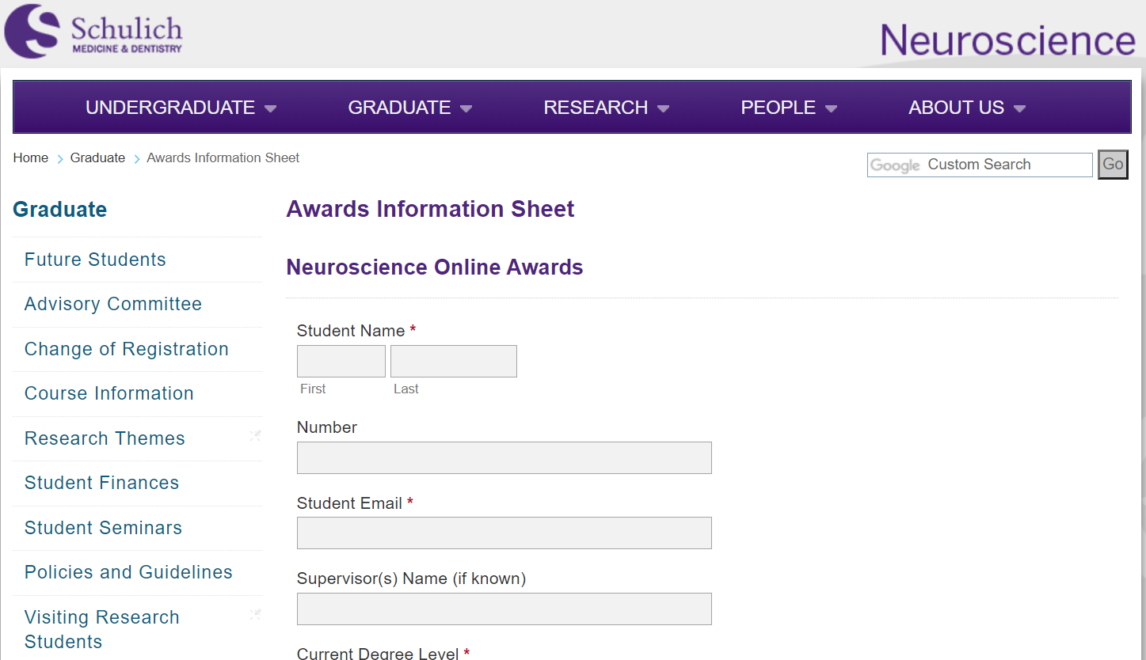
Additional Information
The Neuroscience program asks that anyone applying for Tri-Council Doctoral funding complete the program award information sheet no later than October 1st.
Link to Awards Information Sheet here.

Slide 22
Contact Information
Neuroscience Administration
susan.simpson@schulich.uwo.ca Contact me: konuska@uwo.ca or Sarah: skearsle@uwo.ca
CIHR support-soutien@cihr-irsc.gc.ca
NSERC schol@nserc-crsng.gc.ca
SSHRC fellowships@sshrc-crsh.gc.ca

