Slide 1
SONGS Information Session Committee Presents:
Canada Graduate Scholarship – Doctoral (CGS-D)
Information Session
Presented by: Chloe Cheung
Chair of the Information Session Committee
https://songsuwo.ca/information-sessions

Slide 2
Agenda
1. Presentation on CGS-D Key Information
2. Q&A Period with Susan Simpson
3. Faculty/Student Award Winner Panel
*Slack Channel for CGS-D Application Questions (Opening ~1 week before Sept 23 application deadline)

Slide 3
Presentation Overview
1. What is the Tri-Council CGS-D Program?
2. Who is eligible?
3. Which agency should you apply to?
4. Timeline and overview of the application components

Slide 4
The Canada Graduate Scholarships – Doctoral Program (AKA Tri-Council/Tri-Agency Doctoral Scholarship)
The Canada Graduate Scholarships – Doctoral (CGS-D) program is a federal program of scholarships awarded through national competitions by the federal granting agencies:
1. The Canadian Institutes of Health Research (CIHR)
2. The Natural Sciences and Engineering Research Council of Canada
(NSERC)
3. The Social Science and Humanities Research Council (SSHRC).
Canada’s three federal granting agencies have harmonized the Doctoral (CGS-D) Program which involves a new common CGS-D webpage, a harmonized timeline, and evaluation criteria. ​

Slide 5
CIHR
CIHR
For clinical research
Frederick Banting and Charles Best Canada Graduate Scholarships-Doctoral Awards (CGS-D) Program: $35,000 per year for 36 months (Held in Canada)
The Doctoral Foreign Study Awards (DFSA): $35,000 per year for 36 months (Held Abroad)
Number of Award Winners at Western:
2019
11 CGS-D
2020
13 CGS-D
2021
7 CGS-D

Slide 6
NSERC
NSERC
For non-clinical research
1) Alexander Graham Bell Canada Graduate Scholarships-Doctoral (CGS-D) Program: $35,000 per year for 2 or 3 years (Held in Canada)
2) NSERC Postgraduate Scholarships-Doctoral (PGS-D) Program: $21,000 per year for 2 or 3 years (Held in Canada or Abroad) *Both awards use the same application process
Number of Award Winners at Western:
2019
12 CGS-D
17 PGS-D
2020
15 CGS-D
23 PGS-D
2021
11 CGS-D
25 PGS-D

Slide 7
Applicant Eligibility
CIHR
NSERC
An applicant must:
1) Be a Canadian citizen, a permanent resident of Canada, or a Protected Person under subsection 95(2) of the Immigration and Refugee Protection Act (Canada), as of the application deadline date (Sept 23, 2022)
2) Have completed no more than 24 months of full-time study in their doctoral program by December 31 of the calendar year of application if previously enrolled in a master’s program
3) Have completed no more than 36 months of full-time study in their doctoral program by December 31 of the calendar year of application if enrolled in a joint program; for example, MD/PhD, DDS/PhD
Note: Applicants who fall into this category have access to the 36-month window whether or not they were previously enrolled in a master’s program
4) Have completed no more than 36 months of full-time study in their doctoral program by December 31 of the calendar year of application if enrolled directly from a bachelor’s to a PhD program (with no time spent in a master’s program)
Note: Direct-entry applicants must be enrolled in their doctoral program at the time of application
5) If you were registered in a master’s program and subsequently transferred to a doctoral program (fast-track/roll-over), the months of study completed are calculated starting from the date on which you transferred into the doctoral program

Slide 8
Determining Which Funding Agency is Right for You
CIHR
NSERC
Talk to your supervisor about which agency your research project/ proposal would be the best fit for (especially if your research includes both clinical and non-clinical work!)
Check to see which funding agency your supervisor is typically funded under.
Check out the eligibility guidelines in more detail at: https://science.gc.ca/eic/site/063.nsf/eng/h_FEE7261A.html?OpenDocument

Slide 9
Application Process
CIHR
NSERC
Online application submitted through Western University
Application Deadline: September 23rd, 2022 (8:00 p.m. ET)
Western will review all applications received, rank them and submit the recommended applications to the agencies by November 21st, 2022
Results: By April 30th, 2023
Application Forms:
CIHR: ResearchNET (for more info, see https://grad.uwo.ca/finances/external_funding/cihr.html)
NSERC: NSERC Online System (for more info, see https://grad.uwo.ca/finances/external_funding/nserc.html)
Select the PGS-D application form to apply for CGS-D (you will be considered for both awards)
Registered Western students must select Option C in the application
SSHRC: SSHRC Online System

Slide 10
Application Process
CIHR
NSERC
Online direct application to Council Agency
Application Deadline: October 17th, 2022 (8:00 p.m. ET).
Results: By April 30th, 2023
Application Forms:
CIHR: ResearchNET
NSERC: NSERC Online System
Select the PGS-D application form to apply for CGS-D (you will be considered for both awards)
SSHRC: SSHRC Online System

Slide 11
Up-to-Date Official Transcripts
CIHR
NSERC
Up-to-date official transcripts are mandatory for CIHR and NSERC
1) Up-to-date = official transcripts dated or issued in the Fall 2022 term (if currently registered) OR after the last term completed (if not currently registered).
2) Official = transcripts issued by the institution’s registrar’s office. Transcripts from other sources are NOT official (E.g., Web printouts of grades from your personal account on a university’s website).
Paper Transcripts must be scanned (black and white recommended) and saved as a single (unprotected) PDF file.
Transcript text orientation should be upright (if possible) and must be readable on a computer monitor without any adjustment by the viewer.
Opening the transcript envelope and scanning the transcript WILL NOT render the transcript unofficial.
One copy of an institution’s legend must be included as the last page of that institution’s transcript.
*Applications that do not have adequate documentation to prove applicant eligibility will be irreversibly rejected.
Ordering Western official (e)transcripts must now be done online for either pick-up or mail delivery. https://www.registrar.uwo.ca/services/transcripts.html

Slide 12
Up-to-Date Official Transcripts
CIHR
NSERC
NSERC Applicants: You will upload a copy of your up-to-date official transcripts to the NSERC Online System yourself.
CIHR Applicants: You will upload a copy of your up-to-date official transcripts to ResearchNET yourself.
Get your transcripts as soon as possible!
Ordering Western official (e)transcripts must now be done online for either pick-up or mail delivery. https://www.registrar.uwo.ca/services/transcripts.html

Slide 13
References
CIHR
NSERC
If you haven’t already, contact your references!
Tips for Selecting Your 2 References
Select references who know you well and are capable of making an informed assessment based on the weighted criteria provided by the Tri-Funding Agencies.
Consider past and/or current supervisors!
2. Be upfront and ask your potential references if they have the time and can provide a supporting assessment that will speak to all aspects of the strengths of the application.
Provide your potential referees with a package of information that will assist them with writing
the appraisal. This package could contain:
A) Current curriculum vitae
B) Transcripts
C) List of research contributions; ask your referees to address the importance of your
publications/contributions in their assessment.
D) A representative copy of the research proposal

Slide 14
PINs - CIHR
CIHR
For CIHR, applicants must get a PIN. This will be unique to your application and will be needed for completing your application.
How to get a CIHR PIN: https://cihr-irsc.gc.ca/e/38201.html

Slide 15
PINs - NSERC
NSERC
For NSERC, applicants do not have to get a PIN to submit an application.
If you have a PIN from a prior NSERC application, you can enter it into the form.
If you don’t have a PIN, leave that space blank on the form and NSERC will assign a PIN to you when they receive your application.
See below for more information on your NSERC PIN:
https://www.nserc-crsng.gc.ca/onlineservices-servicesenligne/instructions/201/pgs-pdf_eng.asp https://www.nserc-crsng.gc.ca/OnlineServices-ServicesEnLigne/FAQ-FAQ_eng.asp#a4

Slide 16
Part I: The Canadian Common CV
CIHR
This applies to CIHR only!
A web-based application that provides a single, common approach to gathering CV information required for funding agencies.
Steps:
1. If you do not have one, create a CCV account: Welcome to the Canadian Common CV (ccv-cvc.ca)
Recall: if you are applying for a CIHR CGS-D, you will need your CIHR pin to do this: Register with CIHR - CIHR (cihr-irsc.gc.ca)
2. Login, and navigate to the “Funding” subheading under CV:

Slide 17
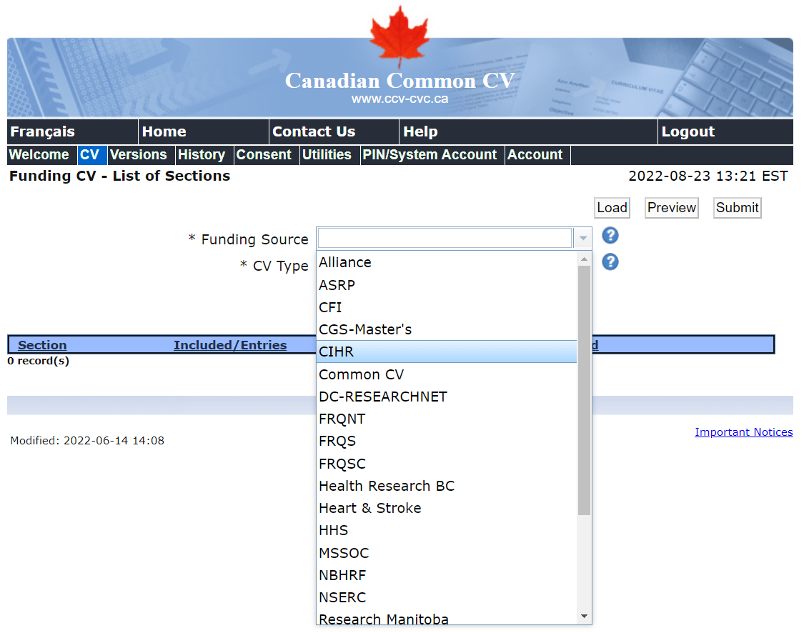
Part I: The Canadian Common CV
CIHR
This applies to CIHR only!
A web-based application that provides a single, common approach to gathering CV information required for funding agencies.
Steps:
3. Under “Funding Source”, choose CIHR

Slide 18
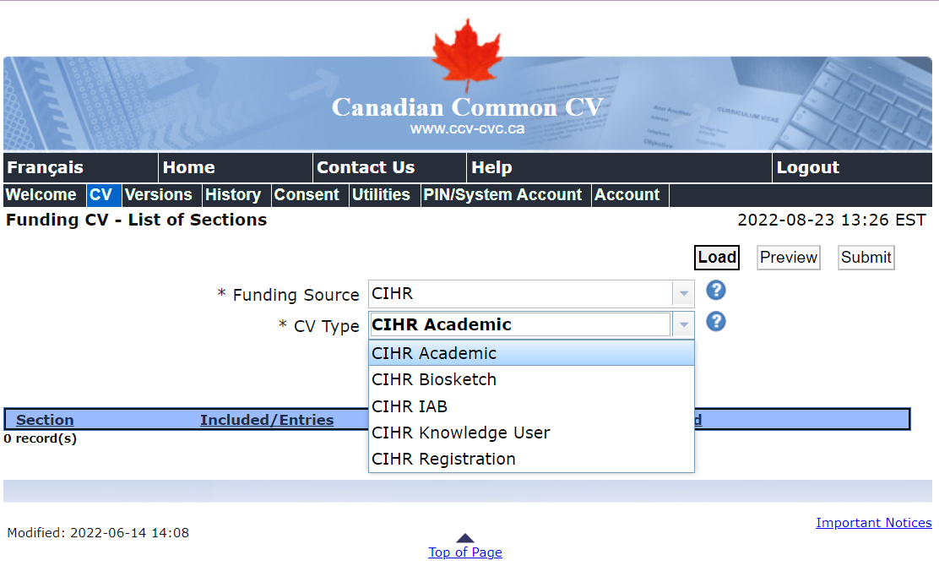
Part I: The Canadian Common CV
CIHR
This applies to CIHR only!
A web-based application that provides a single, common approach to gathering CV information required for funding agencies.
Steps:
4. Under “CV Type”, choose CIHR Academic.
5. Click Load.
6. Fill out the required fields!
START EARLY!
Filling out the Canadian CCV is time consuming!

Slide 19
Part II: Centralized Criteria
CIHR
NSERC
The centralized criteria provides a weighted basis for how you should:
Shape the components of your written application, including your:
Research Project Summary [CIHR]/Research Proposal [NSERC] (1 page for CIHR, 2 pages for NSERC).
Training Expectations [CIHR]/Contributions and Statements [NSERC] (2 pages for CIHR & NSERC).
Optional for NSERC: Justification for Eligibility of Proposed Research
The information that should be highlighted and discussed by your references (2 references for both CIHR and NSERC).

Slide 20
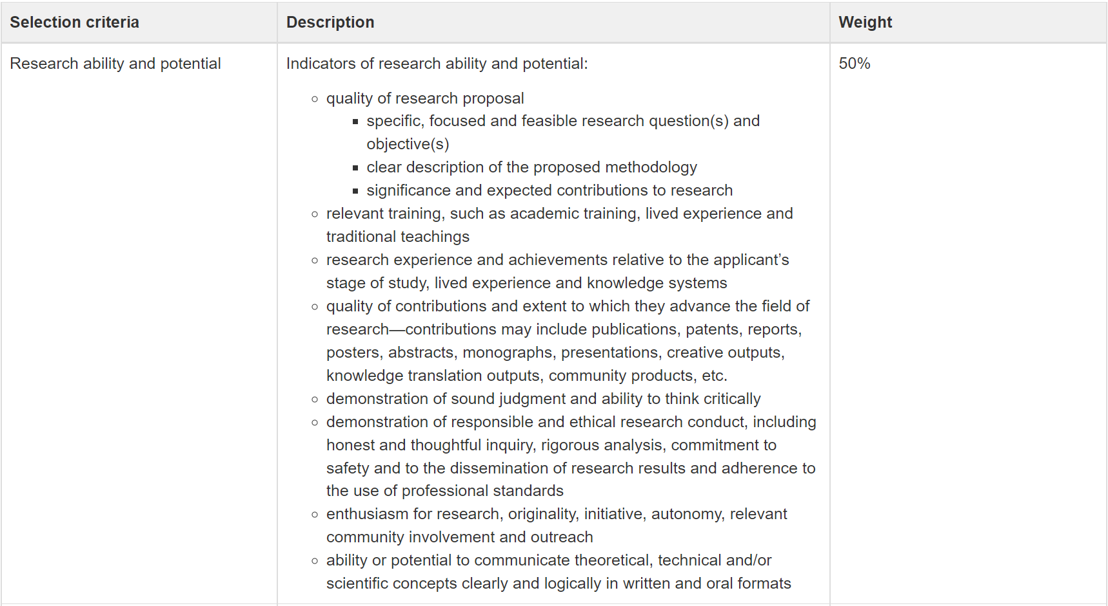
Part II: Centralized Criteria - Research
CIHR
NSERC

Slide 21
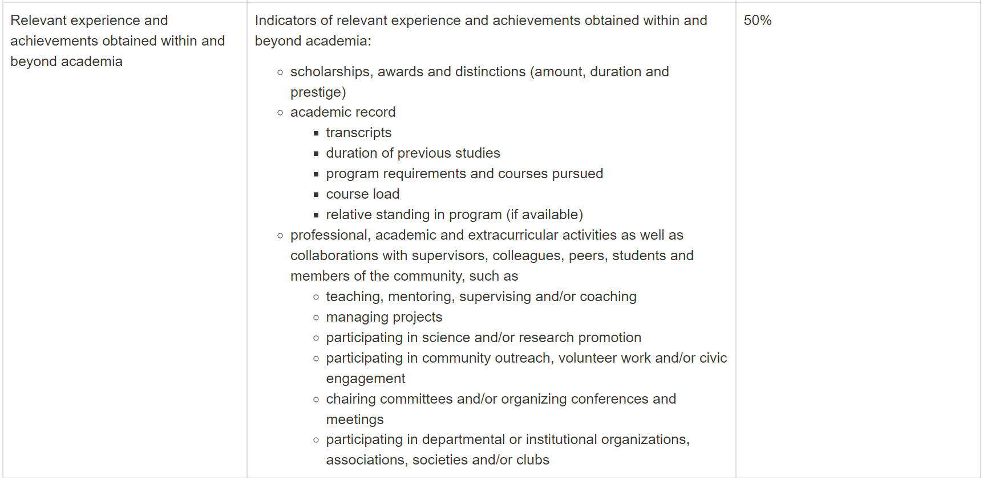
Part II: Centralized Criteria - Other Experience
CIHR
NSERC

Slide 22
EDI
CIHR
NSERC
EDI is a mandatory section for both the CIHR and NSERC CGS-D applications!
What is EDI?
E = Equity
D = Diversity
I = Inclusion
The text of your research proposal must demonstrate reflection and recognition of the existing or perceived barriers experienced by underrepresented groups.
To learn more about EDI in research, see: https://www.uwo.ca/research/services/resources/edi.html

Slide 23
COVID-19 Related Issues
CIHR
NSERC
Interruptions and delays in your studies may be considered in determining eligibility if information on the interruptions and delays is provided in the NSERC and CIHR applications
Reviewers must consider any special circumstances that have influenced the performance and/or productivity of the applicant including special circumstances related to COVID-19 that may have delayed or interrupted the applicant’s studies or research, or otherwise affected the performance on which the assessment for funding will be made. The description of special circumstances should include the following information as needed:
1. The duration of the delay/interruption and if applicable a percentage of reduction in workload;
2. A clear description of its impact, including if relevant, the type of research contribution impacted (e.g. publications, data collection, presentations)

Slide 24
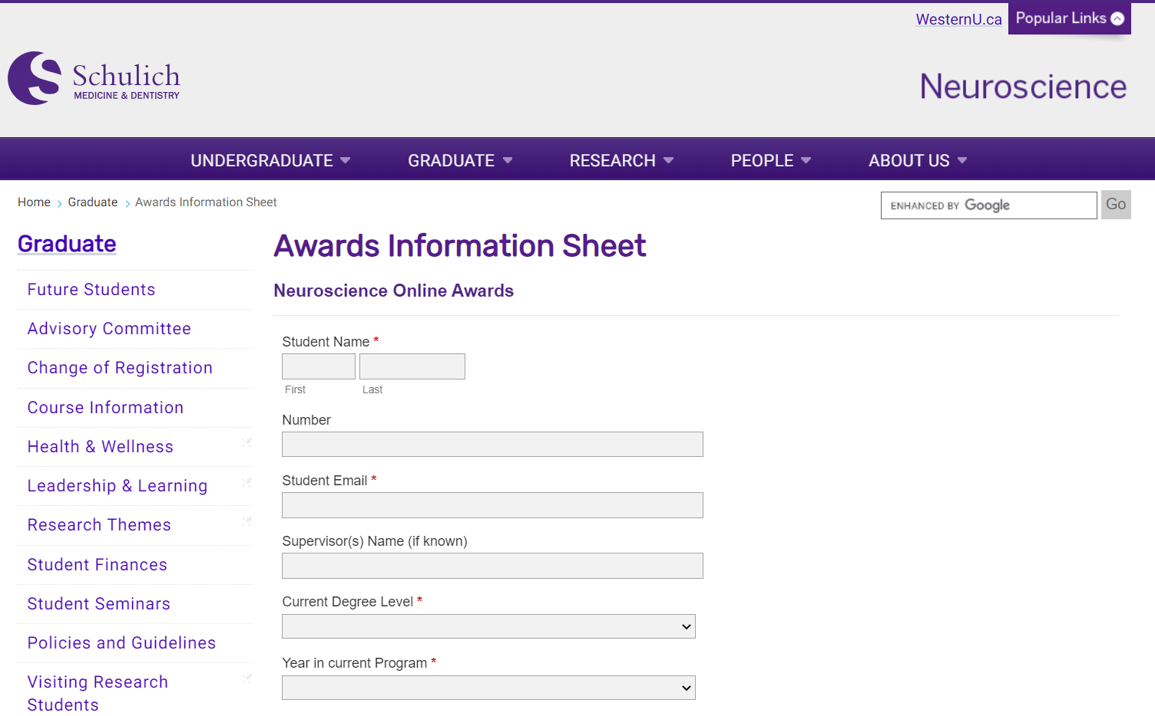
Additional Information
CIHR
NSERC
The Neuroscience program asks that anyone applying for Tri-Council Doctoral funding complete the program award information sheet.
Link to Awards Information Sheet here.

Slide 25
Contact Information
Neuroscience Administration School of Graduate and Postdoctoral Studies Administration
susan.simpson@schulich.uwo.ca pmenzies@uwo.ca Contact me: ccheu252@uwo.ca Greg: gbrook5@uwo.ca
CIHR support-soutien@cihr-irsc.gc.ca
NSERC schol@nserc-crsng.gc.ca
SSHRC fellowships@sshrc-crsh.gc.ca

