Slide 1
SONGS Information Session Committee Presents:
Master’s to PhD Transfer Information Session Presented by: Chloe Cheung Chair of the Information Session Committee

Slide 2
Agenda
Q & A Session with Dr. Brian Corneil
Presentation and overview of Master’s to PhD Transfer
Q & A Session with Susan
Student Transferees/Non-Transferees Panel

Slide 3
Outline
What is the MSc. to PhD Transfer?
The Pros and Cons of Transferring
Timeline for Transferring
Post-Transfer: What’s Next?

Slide 4
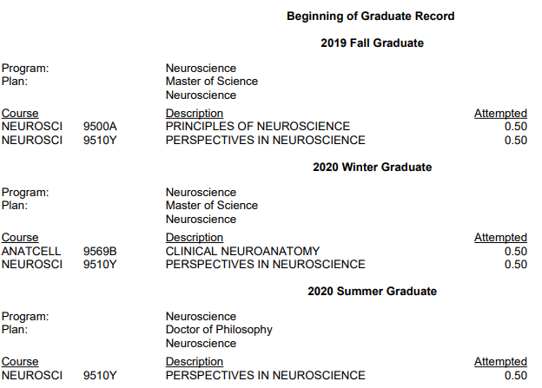
What is a Master’s to PhD Transfer?
If you are (1) interested in completing a PhD and (2) your research project has clearly developed beyond that of a MSc student, you may be permitted to transfer directly to the PhD Program without completing a MSc research thesis NOTE: You will only get a PhD once you graduate.
This type of transfer is often referred to as a “roll over” or “direct transfer”. Your registration will be changed from a Masters of Science in the Neuroscience Program to a Doctor of Philosophy in the Neuroscience Program.

Slide 5
To Transfer or Not to Transfer ?
PROS | CONS
More time to develop a project you love. After transfer, still working on same project as Master’s | Less time to take classes once transferred. Transfer = 5 years, Masters + PhD = 6 years
Finish graduate school faster.* | Less overall time for publications
Lengthy within-lab experience can accelerate/increase publications. | No practice with thesis writing or defense prior to PhD thesis and defense
Stipend generally increases at the PhD level. | External Funding is more competitive, harder to get without publications/less graduate student experience.
Transferring might be for you if:
1. Completing a PhD is one of your goals.
2. You’ve made great progress thus far into your MSc.
3. You have a project that could be developed into a PhD thesis.
4. You love your current lab/supervisor and the research work you do.

Slide 6
When to Transfer?
The approval and transfer to the PhD program must take place by the end of your fifth term.
For example: You started your MSc. in Fall Term 2022 and transferred at the end of Winter Term 2024.
Term 1
Term 2
Term 3
Term 4
Term 5
Term 6
Fall 2022
Winter 2023
Summer 2023
Fall 2023
Winter 2024
Summer 2024
Date Transferred
Deadline to Transfer
(May 1st)
Recommended: Submit the request at least FIVE WEEKS before the start of the upcoming term to ensure correct registration.

Slide 7
How to Transfer?
Talk to lab members and others in the program
Discuss Transferring with Supervisor(s)
Schedule Committee Meeting
Do this as early as you want!
Make sure to have this conversation before scheduling a committee meeting.
Specify to Advisory Committee (AC) that it is a Transfer Meeting and allot 1.5 hours.
Book meeting at about 18 months into Master’s (4th committee meeting)

Slide 8
How to Transfer?
Submit Documents to Advisory Committee Members
Present at committee meeting
AC Program Rep submits completed paperwork
Talk to lab members and others in the program
Discuss Transferring with Supervisor(s)
Schedule Committee Meeting
Progress Report of Research (5+ Pages)
PhD Project Plan (1 Page)
CV
Do this 1 week before AC Meeting
Evaluated based on:
CV
Potential for expanding Master’s project into PhD

Slide 9
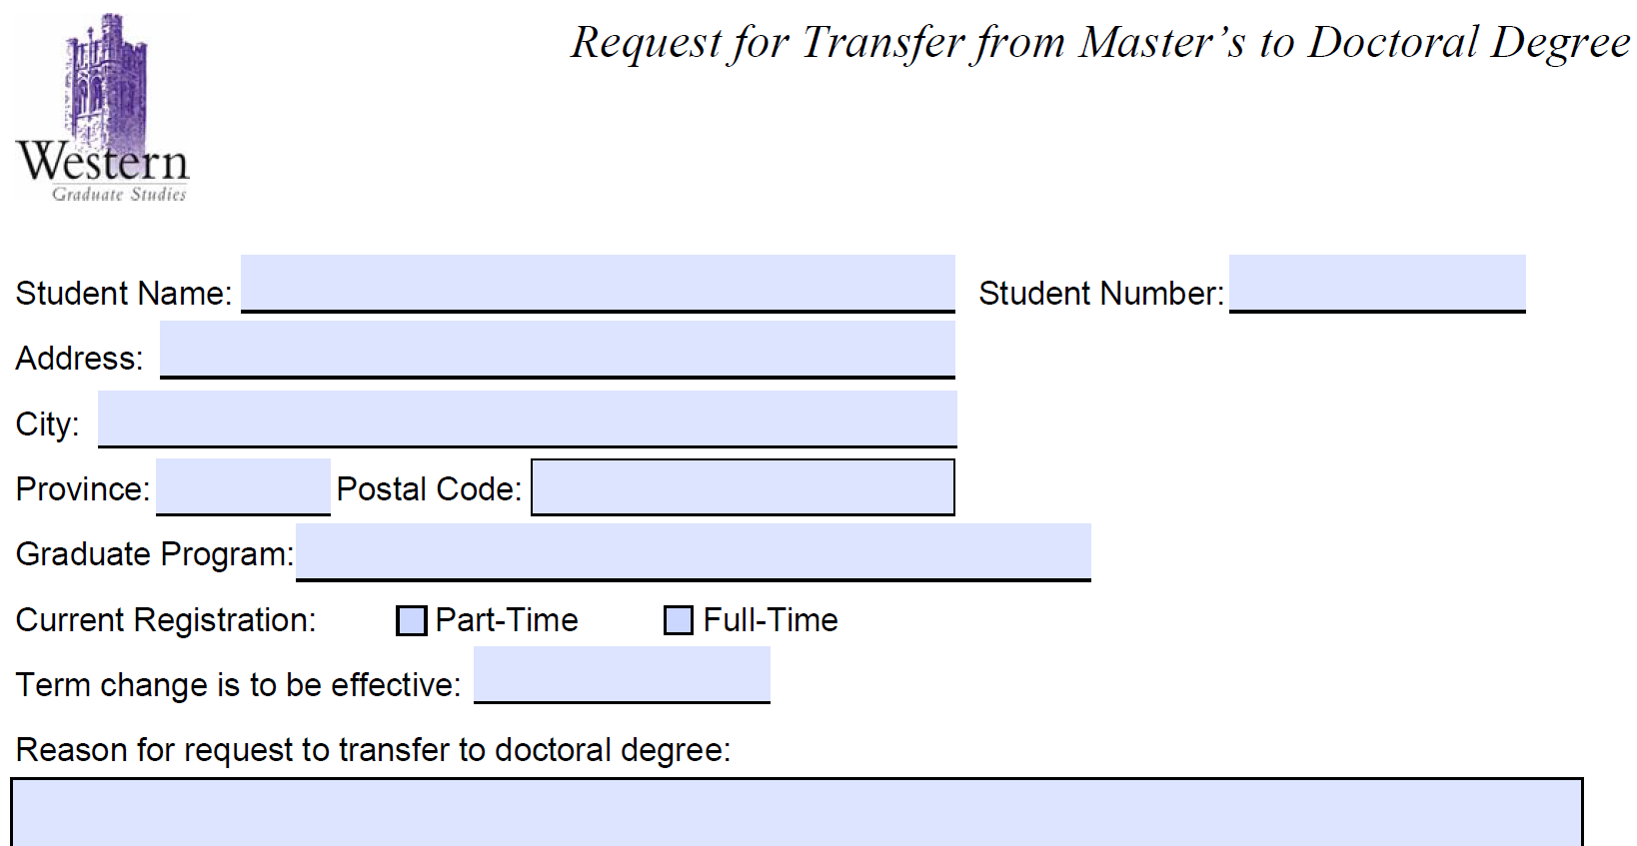
AC Program Rep will Submit to Susan and CC You
How to Transfer?
AC Meeting MSc to PhD Transfer Form
Submit Documents to Advisory Committee Members
Present at committee meeting
AC Program Rep submits completed paperwork
Talk to lab members and others in the program
Discuss Transferring with Supervisor(s)
Schedule Committee Meeting
Request to Transfer Form
PhD Project Plan

Slide 10
Post-Transfer: PhD Funding
If accepted to transfer, rollover PhD students are guaranteed funding for the following periods of time (if academic progression and eligibility requirements are met)
Funding terms:
PhD students (Roll-Over & Direct Entry): 15 terms (5 years)
In comparison to:
MSc students: 6 terms (2 years)
PhD students: 12 terms (4 years)
18 terms (6 years)
Minimum funding is dependent on supervisor’s home department/faculty but is generally higher for PhD students

Slide 11
Post-Transfer: PhD (Neuroscience) Degree Requirements
PhD Milestones
1. Perspectives in Neuroscience (Neuroscience 9510Y - 9514Y) Student Seminars
2. Comprehensive assessment in Neuroscience (Before 16 months into PhD)
3. Research thesis describing your original scientific research = 3 chapters / articles worth of research at appropriate quality for publication in a peer-reviewed journal
4. Your thesis must be successfully defended in an oral examination which is immediately preceded by a
public lecture
Course requirements
Principles of Neuroscience (Neuroscience 9500A/B) if not already taken at the MSc level.
Grant Writing (Neuroscience 9601B) Taken during PhD after completing the comprehensive assessment.
Additional courses required by the student's Advisory Committee to prepare the student for the comprehensive assessment and/or to provide background for the student's particular area of research.
NOTE: A passing grade of at least 70% is necessary for all courses.

Slide 12
Questions?
Contact:
ccheu252@uwo.ca
susan.simpson@schulich.uwo.ca

