Slide 1
SONGS Information Session Committee Presents:
New PhD Comprehensive Assessment
Information Session Presented by: Chloe Cheung Chair of the Information Session Committee

Slide 2
Agenda
Presentation on New Comprehensive PhD Assessment
Q&A Period with Dr. Brian Corneil
Student Panel on New Comprehensive PhD Assessment

Slide 3
Presentation Overview
What is the New PhD Comprehensive Assessment?
The 3 Components of the Comprehensive Assessment
Commitment and Timeline of Comprehensive Assessment
Neuroscience 9601B: Grant Writing

Slide 4
What is the Comprehensive Exam?
Course for Credit (% grade)
Complete 1 of the 2 options:
Classic Mode:
Written Exam -> Oral Exam
Grant Writing Exercise:
Written Grant proposal on a topic related to (BUT IS NOT) your own research
PhD students enrolled/transferred prior to Sept 2022 can EITHER:
Take the old comprehensive exam
OR
Take the new comprehensive assessment and grant writing course

Slide 5
Why create the Comprehensive Assessment?
General confusion about Comprehensive Exam process
Expectations
Mentorship
Purpose
Large variance in completion time for Classic mode
Concerns about grant writing exercise
Lacked meaningful feedback from supervisor(s), advisory committee
Subjectivity (e.g., Topic selection: how far outside your PhD is far enough?)

Slide 6
What is the New PhD Comprehensive Assessment?
A milestone (completed/not completed) consisting of 3 exercises to complete before graduation/granting of your PhD
NOT a course (% grade)
Mandatory for Students enrolling/transferring into a PhD Sept 2022 or later
PhD students enrolled/transferred prior to Sept 2022 can EITHER:
Take the old comprehensive exam
OR
Take the new comprehensive assessment and grant writing course

Slide 7
Comprehensive Assessment Components/Exercises
Domain Specific Essay or Review
Public Communication Essay
Chalk Talk

Slide 8
1. Domain Specific Essay/Review
Scholarly, referenced manuscript within your current area of research
Example Formats:
Current trends in your field of study
Historical perspectives on your field of study (e.g., a long-standing controversy, development of a key methodology)
Trends in Neuroscience style review
Systematic or scoping review
Good manuscripts could get published/added to CV

Slide 9
2. Public Communication Essay
Written article for public communication within an area of interest
Example Formats:
Dorsal Column article summarizing a recently published article (often within 5 years of publication)
Journal Club article for the Journal of Neuroscience related to a recently published article (within 2 months of publication)
Good manuscripts could get published/added to CV

Slide 10
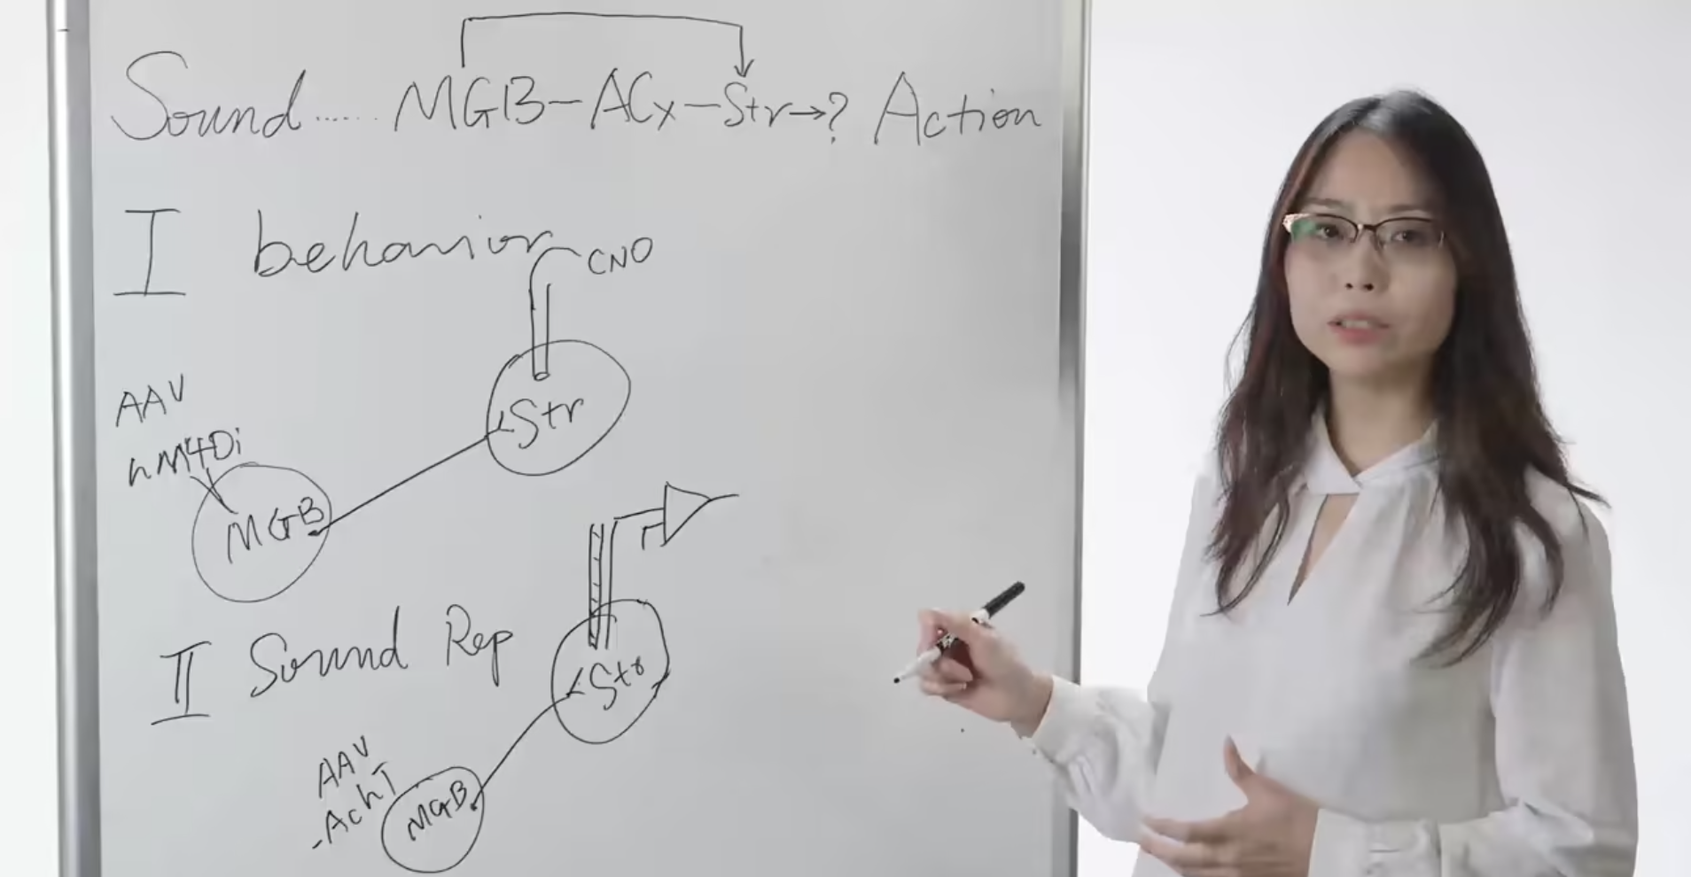
3. Chalk Talk
Interactive Whiteboard Presentation in front of your advisory committee
Example Topics:
Key mechanism in your PhD
Planned experiment for final portion of your PhD
Key methodology in your PhD thesis
Extension of Domain Specific Essay/Review topic
Other topic approved by the advisory committee
Whiteboard presentation
30 minutes
Max 45 mins
Questions from Advisory Committee
Up to
15 minutes

Slide 11
Goals of New PhD Comprehensive Assessment
Assess:
Knowledge and Understanding of domain of study
Critical Thinking
Scientific Literacy
Written and Oral Scientific Communication
Enable advisory committee to identify gaps in knowledge or areas requiring further development
Produce outputs/products you can potentially add to CV and/or publish

Slide 12
Supervisor(s) and Advisory Committee Roles
Role of Supervisor(s)
Students are free to confer with their supervisor(s) and any other outside mentors (other than the advisory committee) for advice and feedback on any of the exercises, in the interests of aiding student development
However, the student is expected to work independently on all three exercises

Slide 13
Supervisor(s) and Advisory Committee Roles
Role of Advisory Committee
Assess all 3 exercises and provide feedback
You may be required to incorporate feedback and repeat a particular exercise until the advisory committee feels you are performing at an appropriate level
Comprehensive assessment must be completed to the advisory committee’s satisfaction to complete the milestone

Slide 14
Timing and Commitment
Comprehensive Assessment should take 1 term to complete, while also fulfilling regular lab and TA duties
Completion Deadline
PhD students with a MSc, MD/PhD students, MSc students transferring into a PhD: 16 months (4 terms) after entry into PhD
Direct-entry PhD students: 28 months (7 terms) into PhD

Slide 15
Timeline
Talk to supervisor(s) about possible topics for the three exercises
Exercises
Do this as early as you want!
Domain Specific Essay/Review
Public Communication Essay
Chalk Talk
PhD Students with a MSc, MD/PhD students, MSc students transferring into a PhD: 2nd PhD advisory committee meeting
Direct-entry PhD students: 3rd or 4th PhD advisory committee meeting
Advisory Committee books Comprehensive Assessment Meeting 3-4 months after topic approval
Propose topics for the three exercises to your Advisory Committee
Exercises
Submit Final drafts of Exercises 1 and 2 to Advisory Committee
Do this 1 week before Comprehensive Assessment Meeting
Domain Specific Essay/Review
Public Communication Essay

Slide 16
Timeline
1.5 hr meeting occurring 3-4 months after topic approval by Advisory Committee
Chalk talk (Presentation 30 minutes + 15 mins of questions = 45 min total)
Student then leaves room, and the advisory committee confers about feedback for all three exercises
Talk to supervisor(s) about possible topics for the three exercises
Present Chalk Talk at Comprehensive Assessment Meeting
Propose topics for the three exercises to your Advisory Committee
Subsequent Meetings if improvement needed
May be required if the advisory committee feels further development or work is required on any of the three exercises.
Once your Advisory Committee is satisfied with your progress…
Advisory Committee Chair informs Neuroscience Office of milestone completion
Submit Final drafts of Exercises 1 and 2 to Advisory Committee
Milestone listed as “complete” on your transcript

Slide 17
Neuroscience 9601B: Grant Writing
Mandatory 0.5 credit course for students completing the new Comprehensive Assessment (First offering Jan 2023)
Required for all students entering the PhD program on or after September 1, 2022
MUST complete Comprehensive Assessment prior to taking this course
Learn how to prepare grant applications in order to improve chances of future success in obtaining research funds

Slide 18
Helpful Resources
Exercise 1: Domain Specific Essay/Review
Trends in Neuroscience “Reviews” or “Opinions” manuscript
Systematic or Scoping Review Information at Western
Systematic or scoping review consultation at Western Libraries
Exercise 2: Public Communication Essay
Dorsal Column
Journal Club article for the Journal of Neuroscience
Exercise 3: Chalk Talk
Society for Neuroscience: What is a Chalk Talk?
The American Society for Cell Biology: Preparing your academic chalk talk

Slide 19
Questions?

