Slide 1
SONGs Information Session
Comprehensive Exam July 2021
Presented by Megan Roussy, Chair of the Information Session Committee
mroussy2@uwo.ca

Slide 2
Comprehensive Examination for PhD Students
The comprehensive examination must be undertaken within the first 18 months of registration in the PhD program.
Students that roll-over into a PhD should complete this program requirement within the first year of PhD registration.
Purpose:
- evaluate the student’s knowledge of their field of research/ related fields
- evaluate the student’s ability to critically reflect on different experimental approaches and to link different concepts
- evaluate the student’s ability to conduct research at the level of a PhD student
Notes:
It usually is recommended that a student start their comprehensive exam after their first chapter is finished

Slide 3
Options
There are two alternative forms of comprehensive examination
Option 1: Classic Comprehensive Examination - Cover 3 Neuroscience topics *Option 2: Grant Writing Exercise - Propose a “PhD’s” worth of research projects (3-5 years) – usually 3 aims
Which format to choose?

Slide 4
Time Requirement
Expected to devote the majority of your time to prepare for / complete the comprehensive exam in the 4 weeks prior to the written exam or submission of the grant proposal.
Supervisors are asked to respect this and should not expect the student to spend much time on experiments during this time period.
Plan your exam to avoid conflicts with research activities.
Students with research activities (i.e. seminar presentation) that conflict with the Comprehensive timeline should consult the Director of the Neuroscience Program to arrange an alternate timeline.

Slide 5
General Steps
Talk to your Supervisor
Step 1
Step 2
Hold an Advisory Committee Meeting
Step 3
Approval of Examiners/Topic(s) Completed by the program office
Step 4
Meet with your Examiners (Classic) or Mentors (Grant Writing)

Slide 6
Committee Meeting
Express your intent to discuss the exam to your committee prior to the meeting
At this meeting you will determine the following:
Which option you will complete (Classic or Grant Writing)
Your timeline
Mentors (Grant Writing only)
Examiners (Three)
Topic: either the topic of your grant proposal OR three different areas within neuroscience for each examiner to test you (Classic option)

Slide 7
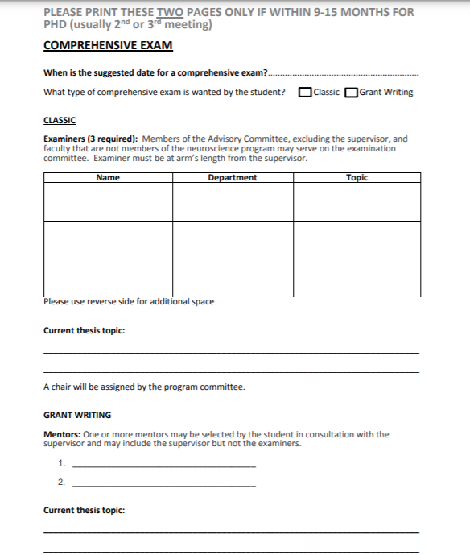
Bring this form with you!
Comprehensive Exam Form

Slide 8
Option 1: Classic Exam​
Cover 3 Neuroscience topics
Often you can propose your topics to your examiners -can be related to your field of work
Meet with examiners to discuss readings/concepts to study
3 steps:
1. Study period – meet with examiners
2. Written exam in which 3 principal questions are answered. ~4h with 3 essay questions​
3. ~2h oral exam with questions based on topic areas​
Purpose: To evaluate (1) student’s knowledge of their research field, (2) ability to solve novel problems, (3) discipline history, (4) currently used methodology and its purpose

Slide 9
Steps: Classic Option
Meet with your examiners to discuss topics
Step 1
Study period interlaced with examiner meetings
Step 2
Written exam
Step 3
1 week
Oral exam
Step 4

Slide 10
Study Period
Preparation feels “course based”​
Over the few weeks/months you will meet with your 3 examiners to discuss the topics in detail (main themes and important details)​
They will assign relevant material readings/articles based on topics and examiners expertise - consult examiners to determine length of article list​
Try setting up meeting times well in advance with your examiners​
Meet with examiners on a regular basis, analogous to going to class​
This is your “study period”, leading up to your essay style exam​

Slide 11
Written Exam (4 hours)​
When ready, contact the Program Coordinator to schedule your written exam​
Style will be dependent on the topics discussed with examiners.​
Questions could be very detailed and specific or general concepts (e.g. history of a field, current controversies)​
Get 2 questions from each examiner, must answer 1 from each examiner​
No specific formatting rules​
Typically fill 1-2 pages per question using a provided laptop (no internet access)​
Exam is graded by faculty; 70% is required on each question to pass​

Slide 12
Oral Exam​
If written exam is a pass (usually marked within 1-2 days)
In ~1 week you will have a “follow-up” oral exam
You will have to defend and showcase your knowledge on your topic areas
2 stages – 1.5-2 hours (no presentation at beginning):
1) Question Period 1 - Each examiner gets 15-20 minutes to question your knowledge of your topics - Quick break permitted at end
2) Question Period 2 - Each examiner gets an additional 5-10 minutes to question your knowledge of your topics
This is typically conversational, though the time limits are followed strictly
Pass or fail by majority vote

Slide 13
How to Prepare​
What to study?
Article details and all overarching themes and topics!
How do the articles and your readings relate to your own research project(s) and how they may shape your project
For the written:
Focus on article readings/details
Be able to reference specific papers in your essay questions
Focus on important definitions
Overall findings on given issues
Limitations
Future research
For the oral:
Covers the overarching themes and topics
You need to show you understand all your material
Know it well enough that you can talk about it readily and easily

Slide 14
Option 2: Grant Writing Exercise
The grant is to be written by the student as an independent exercise, but the student will consult with mentor(s) during the initial stages.
The proposal must outline an original research project of 3-5 years (usually 3 aims) The grant proposal should be related to - but not be the same as – your thesis research
3 steps
◦ 1. 1-page general summary
◦ 2. 10-page written report
◦ 3. ~2h oral defense
Overlap in 1-2 of 3 areas:
- Methodology
- Topic
- Model

Slide 15
Steps: Grant Option
Meet with your mentor(s)
Step 1
Write 1 page summary
Step 2
4 weeks
Submit written full report
Step 3
2 weeks
Oral defense
Step 4

Slide 16
Meet your Mentors
1) Brainstorm what overarching question(s) you want to answer – narrow your topic
• Background readings to ensure this work has not been done • Outline aims • While you may have certain methods or studies in mind that is related to your proposal, be sure your aims fall under a common theme or title
2) After you have a honed topic - have several meetings/emails with your mentors:
• Streamline aims/scope & hypotheses • Discuss practicality & caveats
• Review experimental design and proposed analysis
• Don’t show up empty handed

Slide 17
Summary Page
Overall, the summary should give your examiners a clear picture of the (1) questions and (2) experiments you are covering in your proposal
Summary Page Outline Suggestions:
- Introduction - Overarching inclusive statement - Key background information - Outline Aim 1 - Rational - Hypothesis - Methodology - Outline Aim 2 and Aim 3 with same subsections - Conclusion - Significance statement
Once you submit your summary page to the Program Coordinator, you can no longer consult your mentors

Slide 18
Full Grant (10 Page Body)
Must submit your full grant 4 weeks after your summary page
Expand on what you’ve outlined in your proposal
7 main sections:
1) Abstract
• < 250 words
3) Background
• Review of literature necessary to understand your proposal
• ~ 3 pages
4) Research design and methods
• Specify the details of each aim
5) Future directions
6) Feasibility
• not necessary section
7) Overall significance/Implications • ~1/3 to 1/2 a page
2) Summary
• < 500 words
• A longer version of the abstract, and more specific version of your original summary page

Slide 19
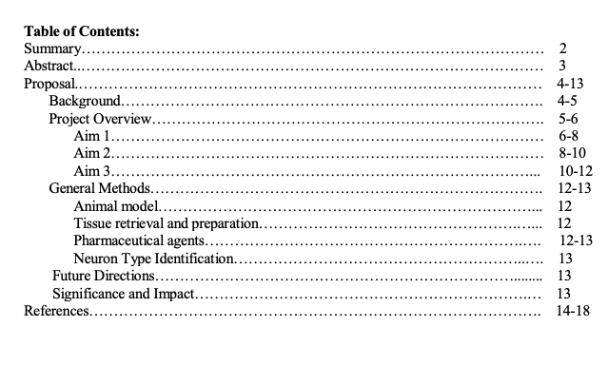

Slide 20
Oral Defense
Program Coordinator will set a date for the oral exam (~2 weeks after submission).
Take these 2 weeks to study and create a presentation for your oral defense.
The proposal will be rated as “Acceptable”, “Acceptable with Minor Revisions”, or “In Need of Major Revision”. At least two out of the three examiners must find the grant proposal “Acceptable”and/or “Acceptable with Minor Revisions” to proceed to the oral exam.
Constructive feedback will also be requested from each examiner.
1. Oral Presentation
• Set up your presentation similar to seminar meetings, or for the 1st year master’s presentation • ~ 15 minutes long
2. Question Period 1 • Each examiner gets 15 minutes to question your knowledge of your proposal and topic -Quick break permitted at end
3. Question Period 2 • Each examiner gets an additional 10 minutes of questions

Slide 21
How to Prepare?
Practice your presentation and answering questions with peers before-hand
What to study?
- Know the background literature your proposal relies on
- Know any relevant pathways/ systems addressed in your proposal
- Know how your methods work and why you chose them
- What do the reagents in immunohistochemistry do?
- What does a local-field potential record?
- What methodological difficulties may there be in the model you are using?
- Consider alternative methods/ approaches
- Answer to why your proposed research is important
- Consider why you expect certain results?
How to answer questions?
- Do not feel rushed to respond. Think before speaking
- Use “backup” slides in your presentation that have diagrams to help explain questions you may anticipate
- If you do not understand the question, try and repeat it back to the examiner, or ask them to rephrase

Slide 22
Exam Outcomes
Permitted 2 attempts at the written examination, or 1 major revision of the grant proposal.
After successful completion of the written component, the student has 2 attempts at the oral component.
If unsuccessful at any of the components the student will meet with their Advisory Committee to determine a course of action, which normally would involve withdrawal from the graduate program.

Slide 23
Resources
Guidelines
Comprehensive Exam Form
Grant Examples – coming soon at https://songsuwo.ca/

