Slide 1
SONGs Information Session Committee Presents:
Masters to PhD Transfer Information Session Presented by: Kate Onuska, PhD Student Chair of the Information Session Committee
konuska@uwo.ca

Slide 2
Outline
What is the MSc. to PhD Transfer?
The Pros and Cons of Transferring
Timeline for Transferring
Post-Transfer: What’s Next?

Slide 3
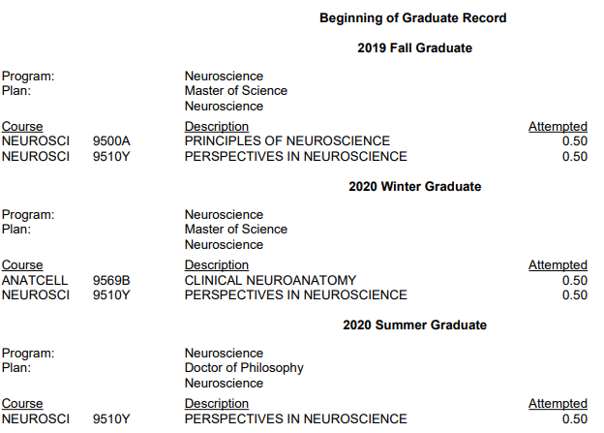
Transfer to PhD
If you are (1) interested in completing a PhD and (2) your research project has clearly developed beyond that of a MSc student, you may be permitted to transfer directly to the PhD Program without completing a MSc research thesis
This type of transfer is often referred to as a “roll over” . Your registration will be changed from a Masters of Science in the Neuroscience Program to a Doctor of Philosophy in the Neuroscience Program.

Slide 4
To Transfer or Not to Transfer ?
PROs | CONs
More time to develop a project you love. | Less time to take classes once transferred.
Finish graduate school faster.* | Less overall time for publications
Lengthy within-lab experience can accelerate/increase publications. | No practice with thesis writing or defense
Stipend generally increases at the PhD level. | External Funding is more competitive, harder to get without publications/less graduate student experience.
Transferring might be for you if:
1. Completing a PhD is one of your goals.
2. You’ve made great progress thus far into your MSc.
3. You have a project that could be developed into a PhD thesis.
4. You love your current lab/supervisor and the research work you do.

Slide 5
When to Transfer?
MSc. to PhD transfers must occur before the end of your fifth academic term of study
For example: I started my Msc. in Fall Term 2019 and transferred at the end of Winter Term 2020 (May)
Term 1
Term 2
Term 3
Term 4
Term 5
Term 6
Fall 2019
Winter 2020
Summer 2020
Fall 2020
Winter 2021
Summer 2021
When I Transferred
Deadline to Transfer
Recommended: submit the request at least FIVE WEEKS before the start of the upcoming term to ensure correct registration.

Slide 6
How to Transfer?
Talk to lab members and others in the program
Discuss Transferring with Supervisor(s)
Schedule Committee Meeting
Do this as early as you want!
Make sure to have this conversation before scheduling a committee meeting.
Do this at least 5 weeks before the end of term
Specify to AC that it is a Transfer Meeting and allot 1.5 hours.
Notes:
. I will take care of the Gradate Chair's signature and forward it to SGPS

Slide 7
How to Transfer?
Submit report(s)/CV to Advisory Committee Members
Present at committee meeting
Submit completed paper work
Talk to lab members and others in the program
Discuss Transferring with Supervisor(s)
Schedule Committee Meeting
Progress Report of Research (5+ Pages)
PhD Project Plan (1 Page)
Do this 1 week before AC Meeting
Bring Request to Transfer Form and Normal AC Meeting Form.
Notes:
When scheduling the meeting please plan for 1.5 hours
Expected to present a progress report of your completed work (5 page limit waived) you will also need to send your advisory committee a 1 page plan for your PhD project
Expected to present your completed work and PhD project plan - You should be prepared to discuss the rationale and conduct of the proposed project
Your Advisory Committee will consider whether your research project is of sufficient scope to expand into a PhD project during the meeting
The committee will also consider your CV
The student, the supervisor, and the advisors have to agree to the “roll-over

Slide 8
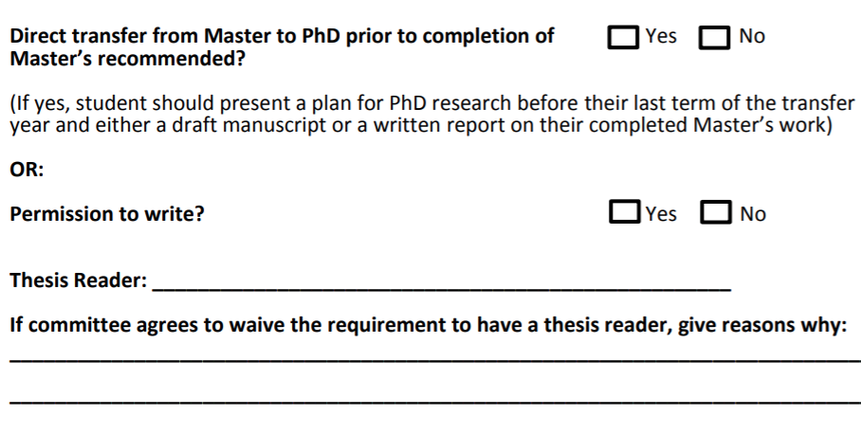
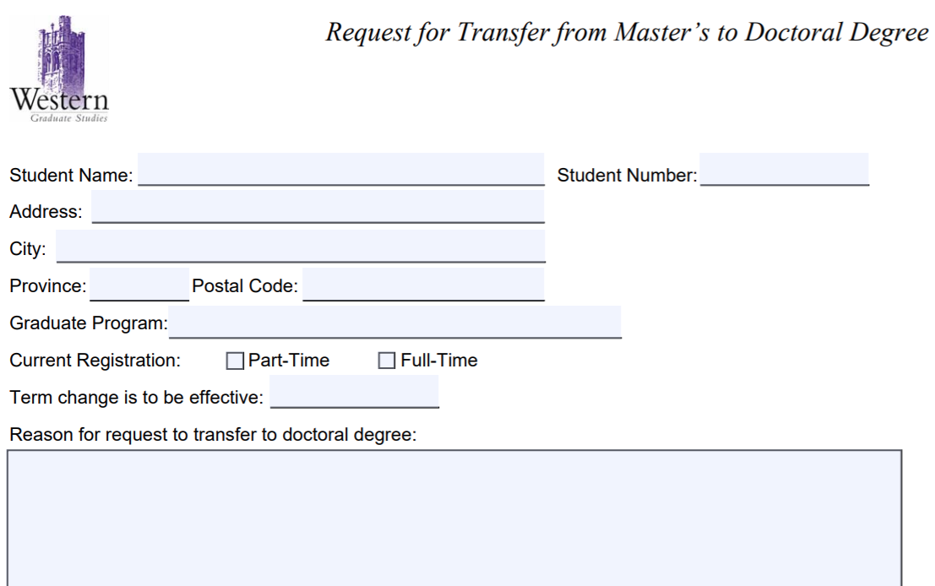
AC Program Rep. will Submit to Susan and CC You
How to Transfer?
AC Meeting MSc to PhD Transfer Form
Submit report(s)/CV to Advisory Committee Members
Present at committee meeting
Submit completed paper work
Talk to lab members and others in the program
Discuss Transferring with Supervisor(s)
Schedule Committee Meeting
Request to Transfer Form

Slide 9
Transferred, now what? : PhD Funding
If accepted to transfer, rollover PhD students are guaranteed funding for the following periods of time (if academic progression and eligibility requirements are met)
Funding terms:
PhD students (Roll-Over & Direct Entry): 15 terms (5 years)
In comparison to:
MSc students: 6 terms (2 years)
PhD students: 12 terms (4 years)
Minimum funding is dependent on supervisor’s home department/faculty but is generally higher for PhD students

Slide 10
Transferred, now what? : PhD (Neuroscience) Degree Requirements
PhD Milestones
1. A comprehensive examination in Neuroscience
2. A research thesis describing original scientific research - 3 results chapters / research of appropriate
quality for publication in a refereed journal
3. The thesis must be successfully defended in an oral examination which is immediately preceded by a
public lecture.
Course requirements
Principles of Neuroscience (Neuroscience 9500A/B) if not taken at the MSc level.
Perspectives in Neuroscience (Neuroscience 9510Y - 9514Y) (student seminar)
Additional courses required by the student's Advisory Committee to prepare the student for the comprehensive examination and/or to provide background for the student's particular area of research (minimum 0.5).
Note: a passing grade of at least 70% is necessary for all courses.

Slide 11
Questions?
Contact:
konuska@uwo.ca
susan.simpson@schulich.uwo.ca

